Slide 1
PRESENTATION ON
FRUIT MART(E-COMMERCE)
PRESENTED BY
Sirisha NB
Syed Waqeer
Farvej Kulmi

Slide 2
PROBLEM STATEMENT
E-commerce provides an easy way to sell products to a large customer base. The purpose of E-commerce website is to help customers narrow down their broad ideas and enables them to finalize the products they want to purchase.

Slide 3
REQUIREMENT
FRONT END
HTML
CSS
JS
Boot Strap
BACK END
Java
H2 database
Springboot

Slide 4
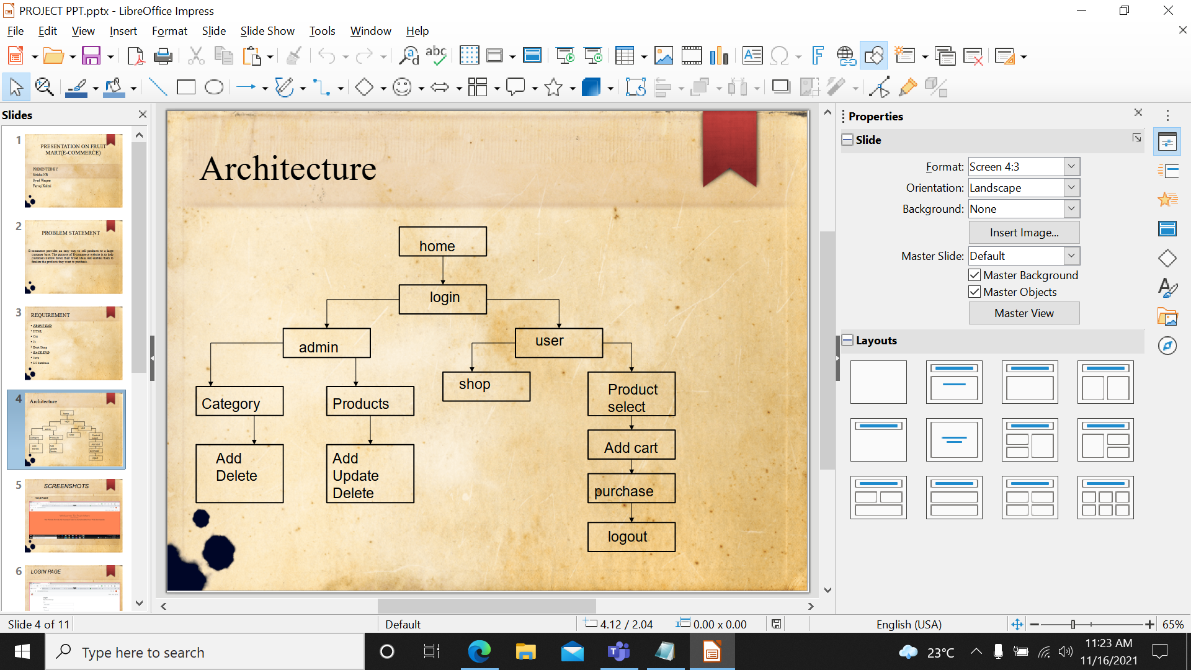
ARCHITECTURE

Slide 5
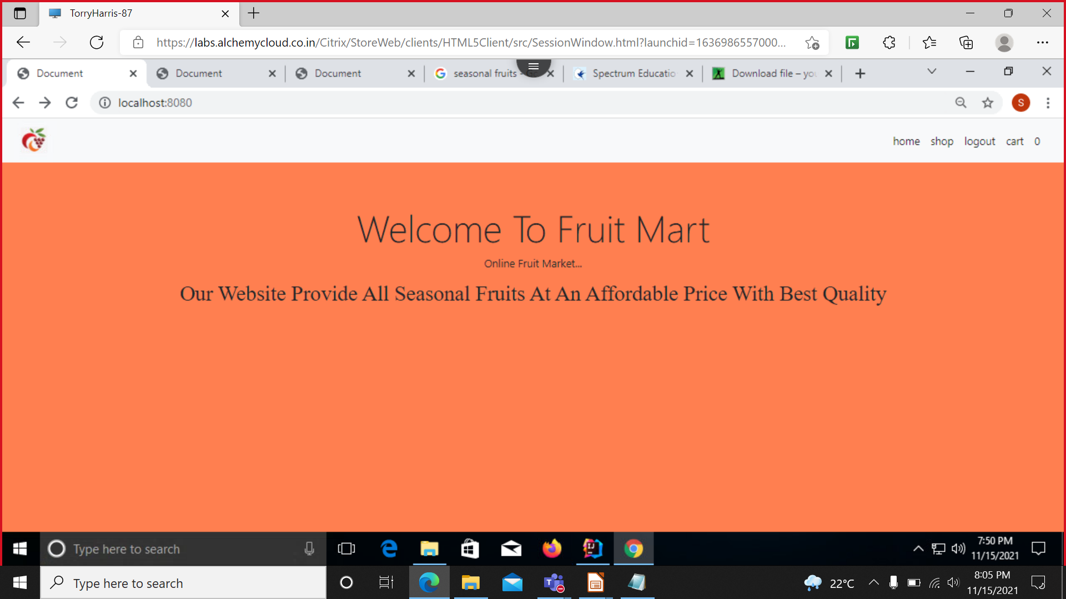
SCREENSHOTS
HOME PAGE

Slide 6
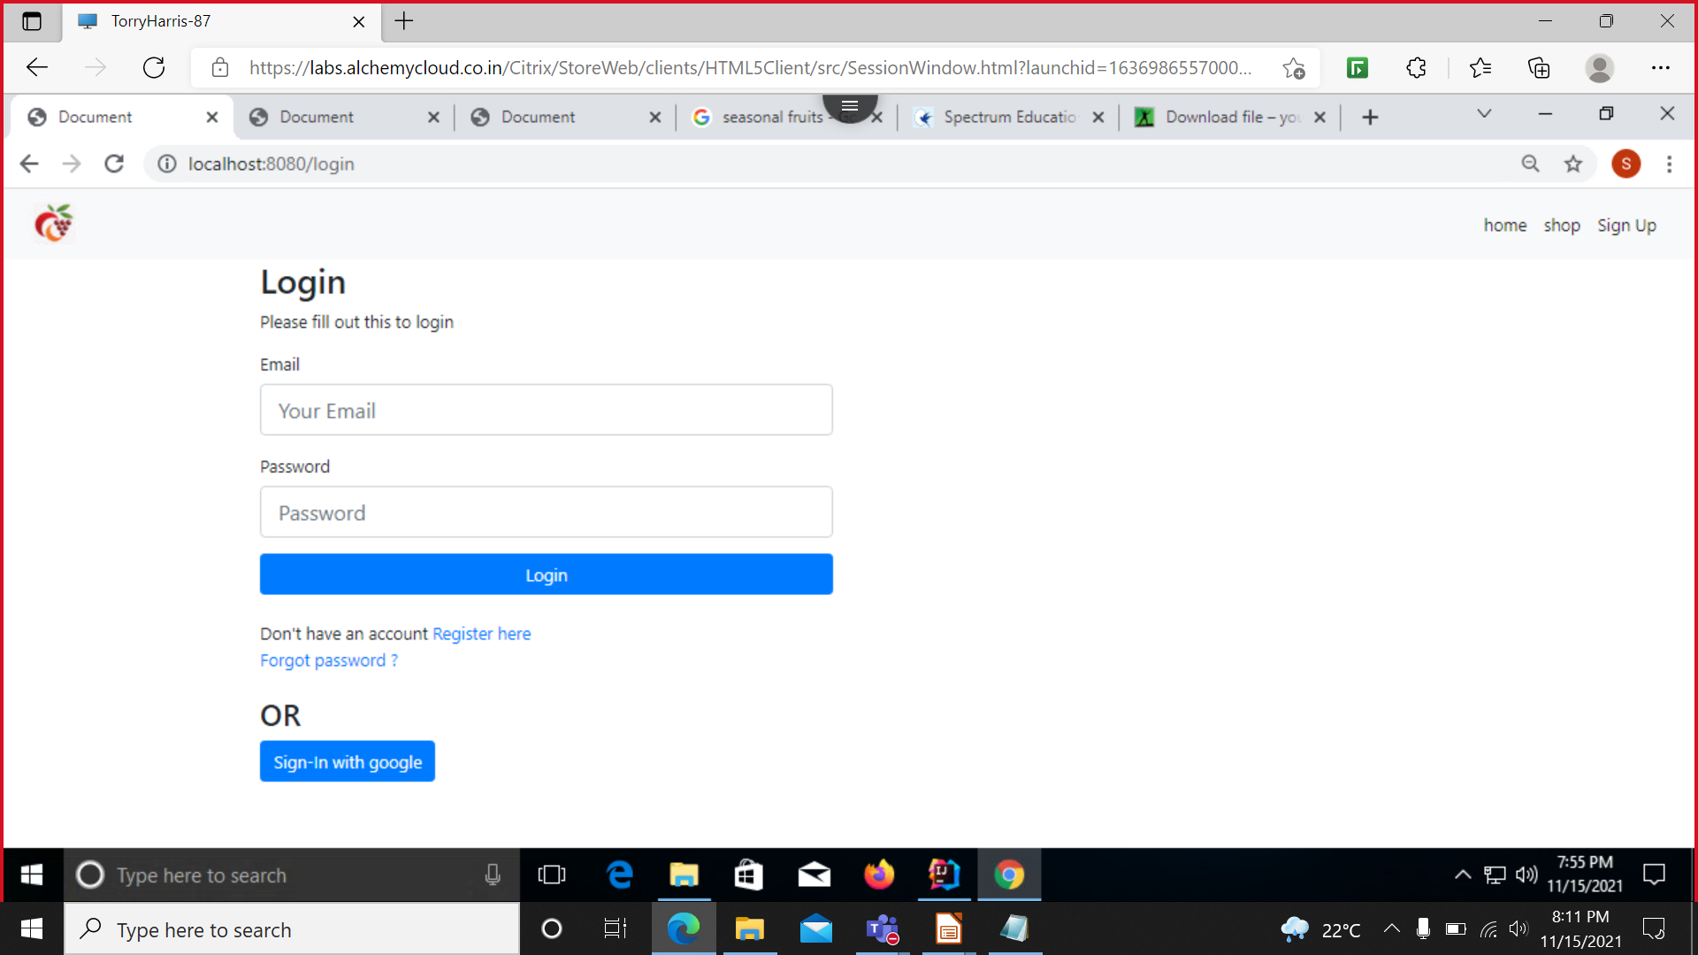
LOGIN PAGE

Slide 7
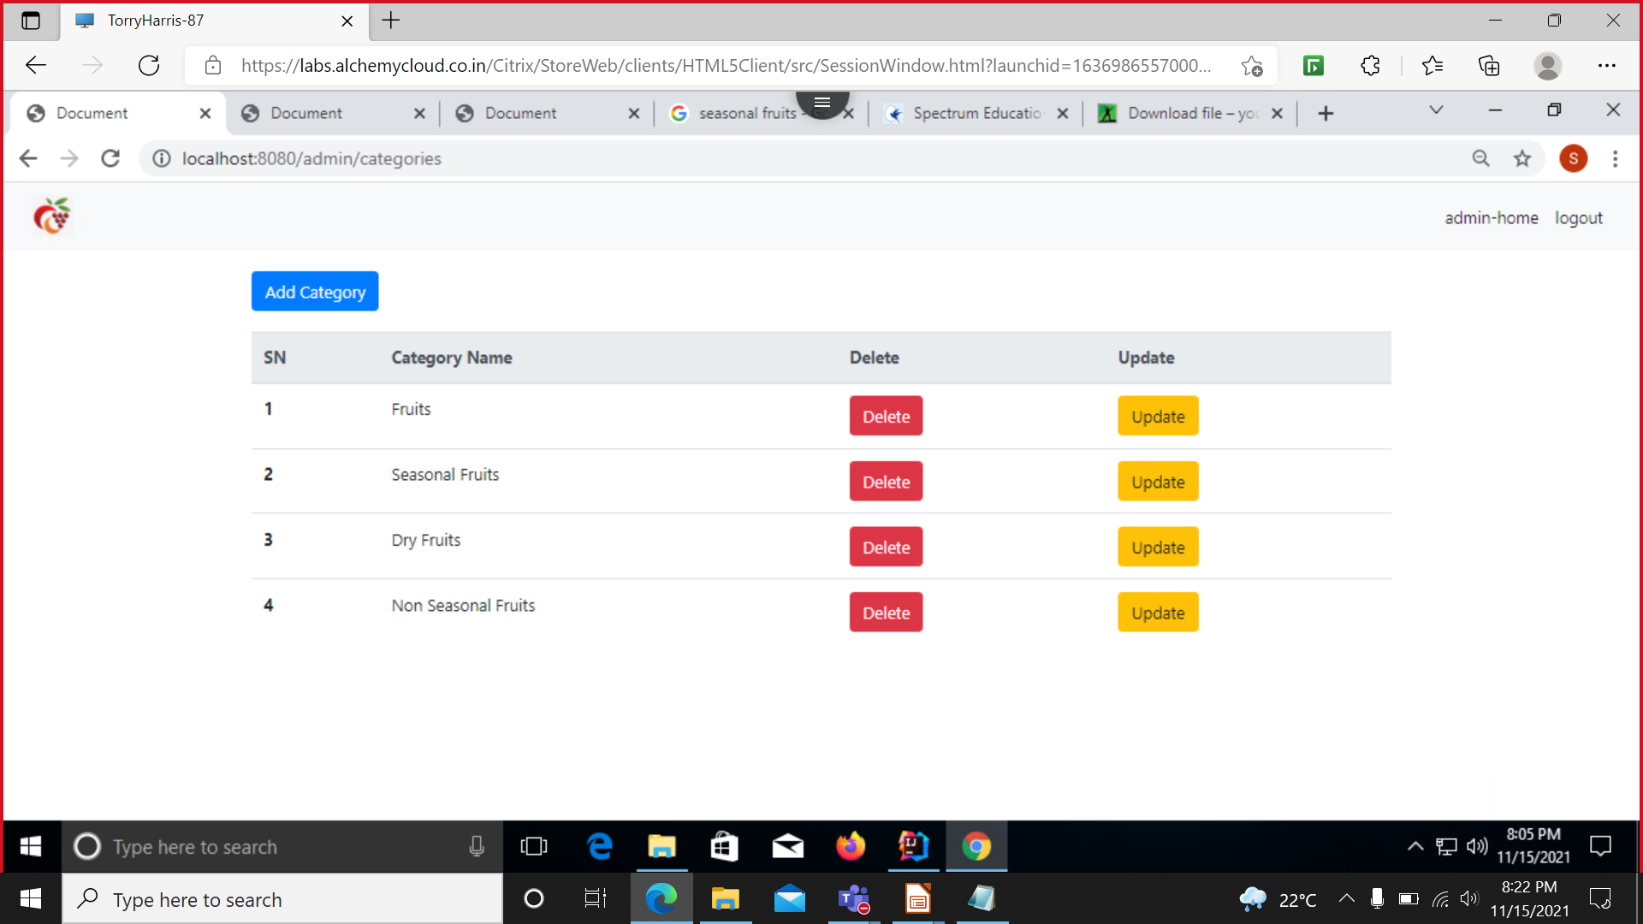
CATEGORY PAGE

Slide 8
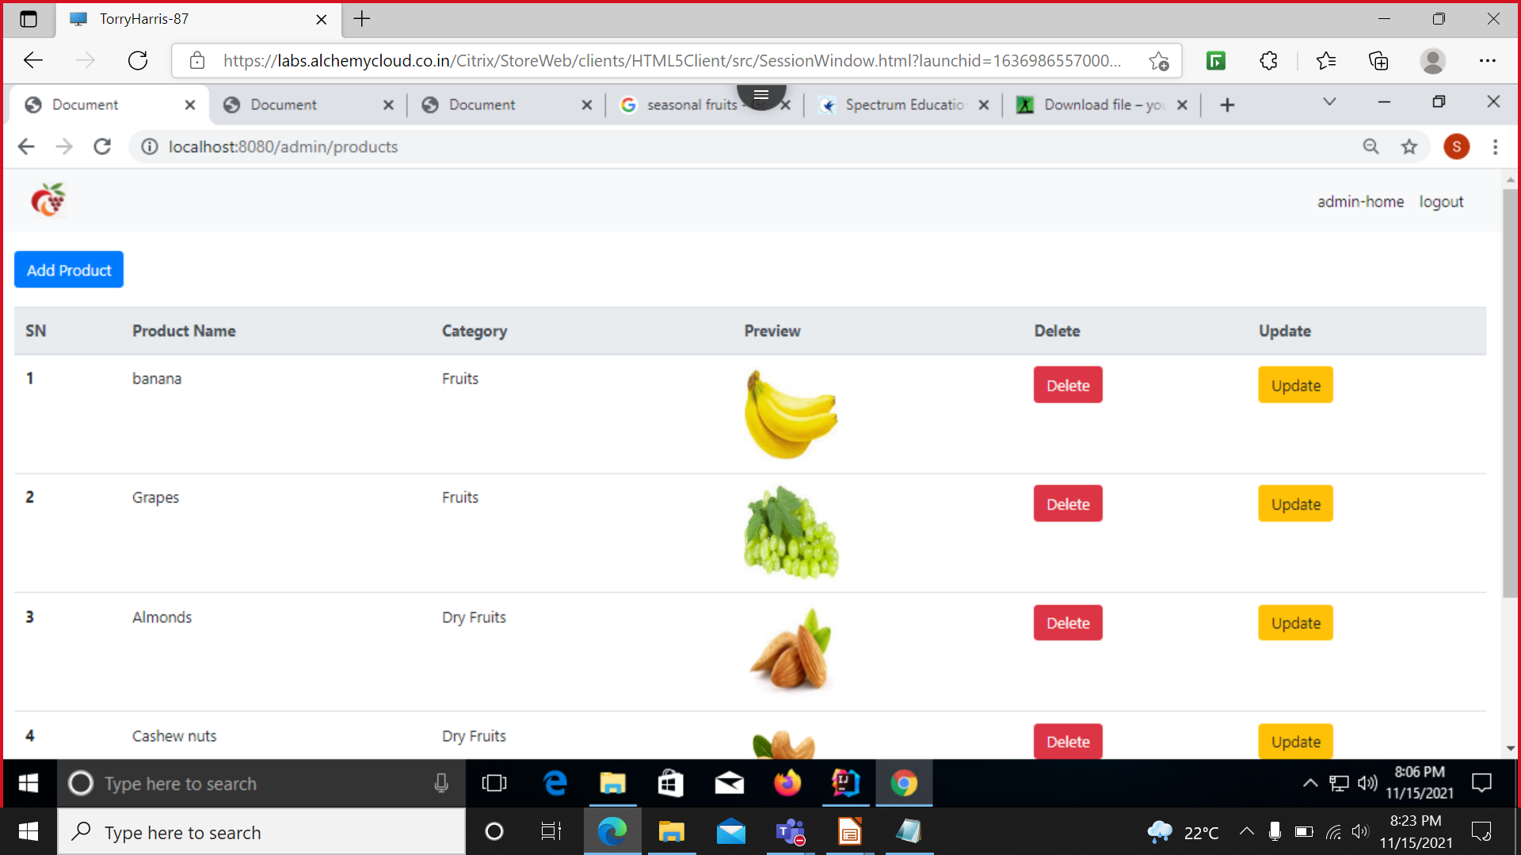
PRODUCT PAGE

Slide 9
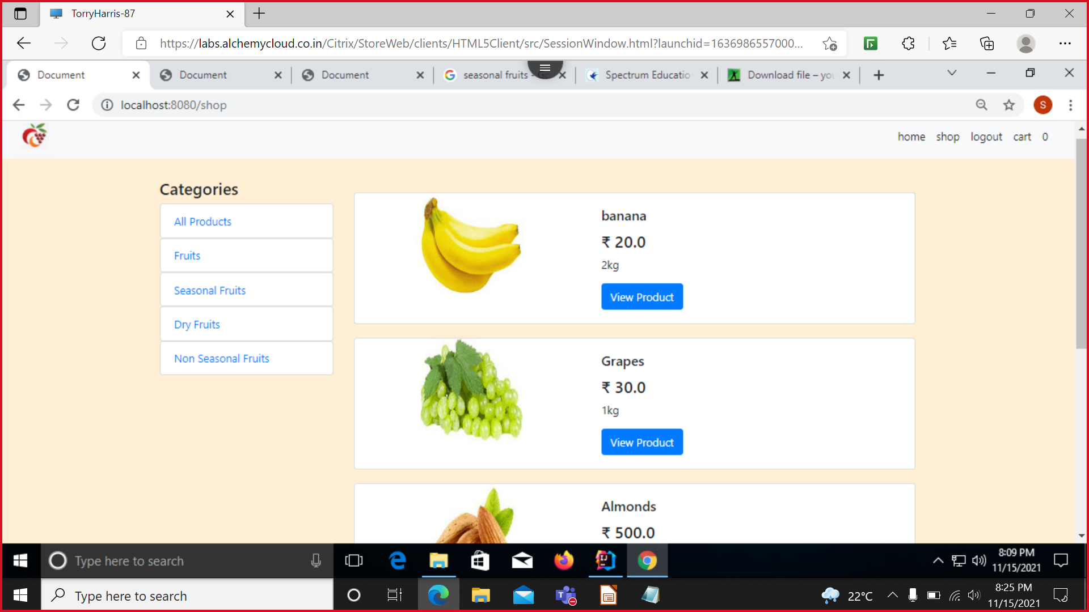
SHOP PAGE

Slide 10
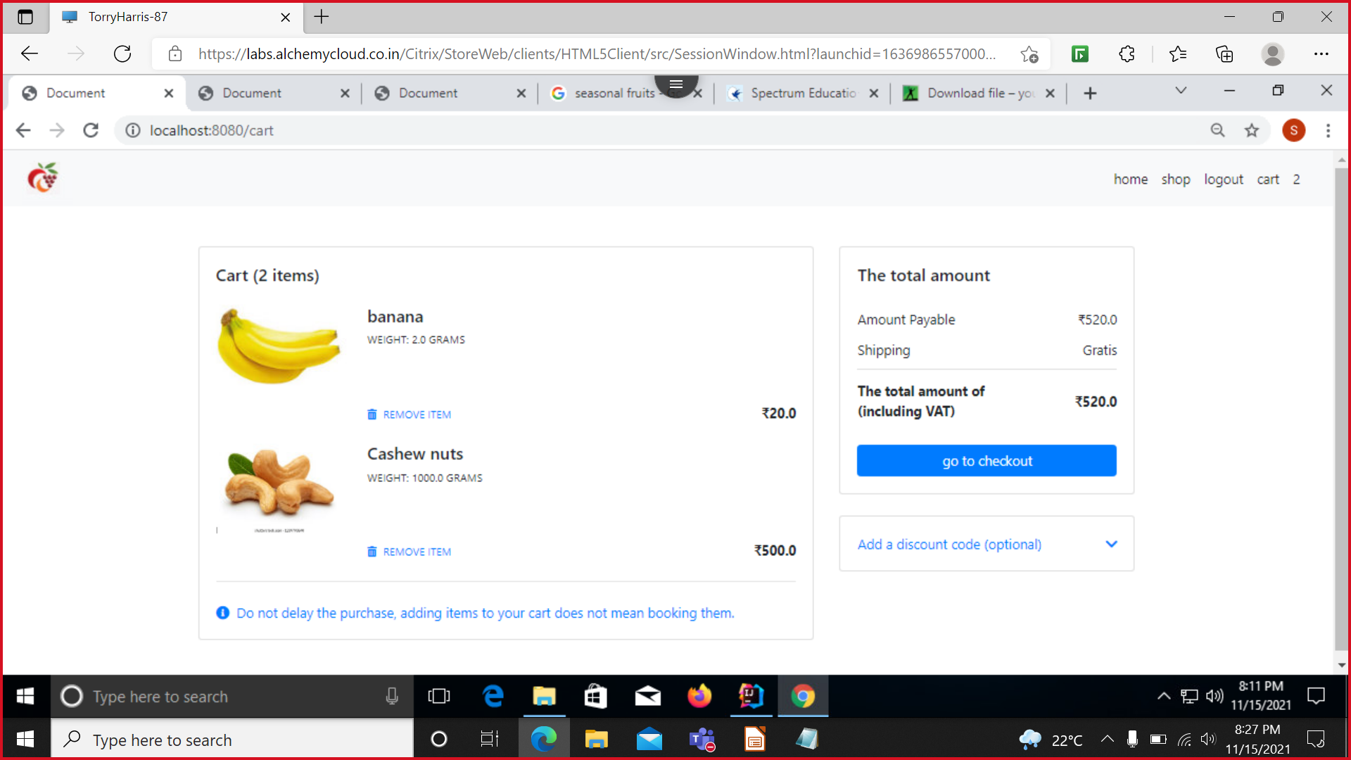
CART PAGE

Slide 11
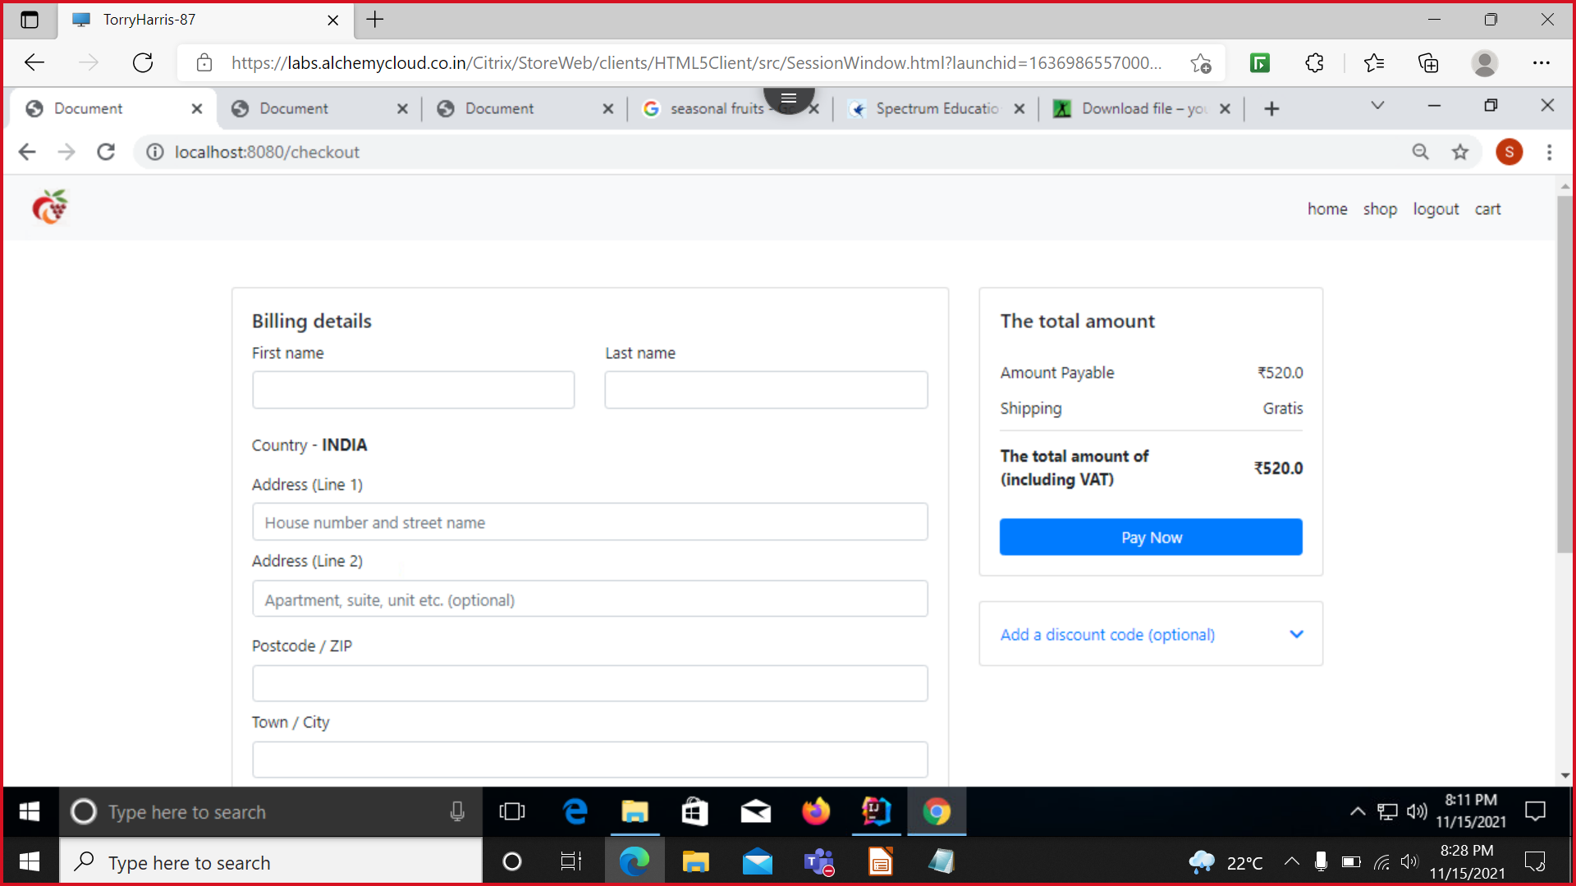
CHECKOUT PAGE

Slide 12
THANK YOU

